Slide 1
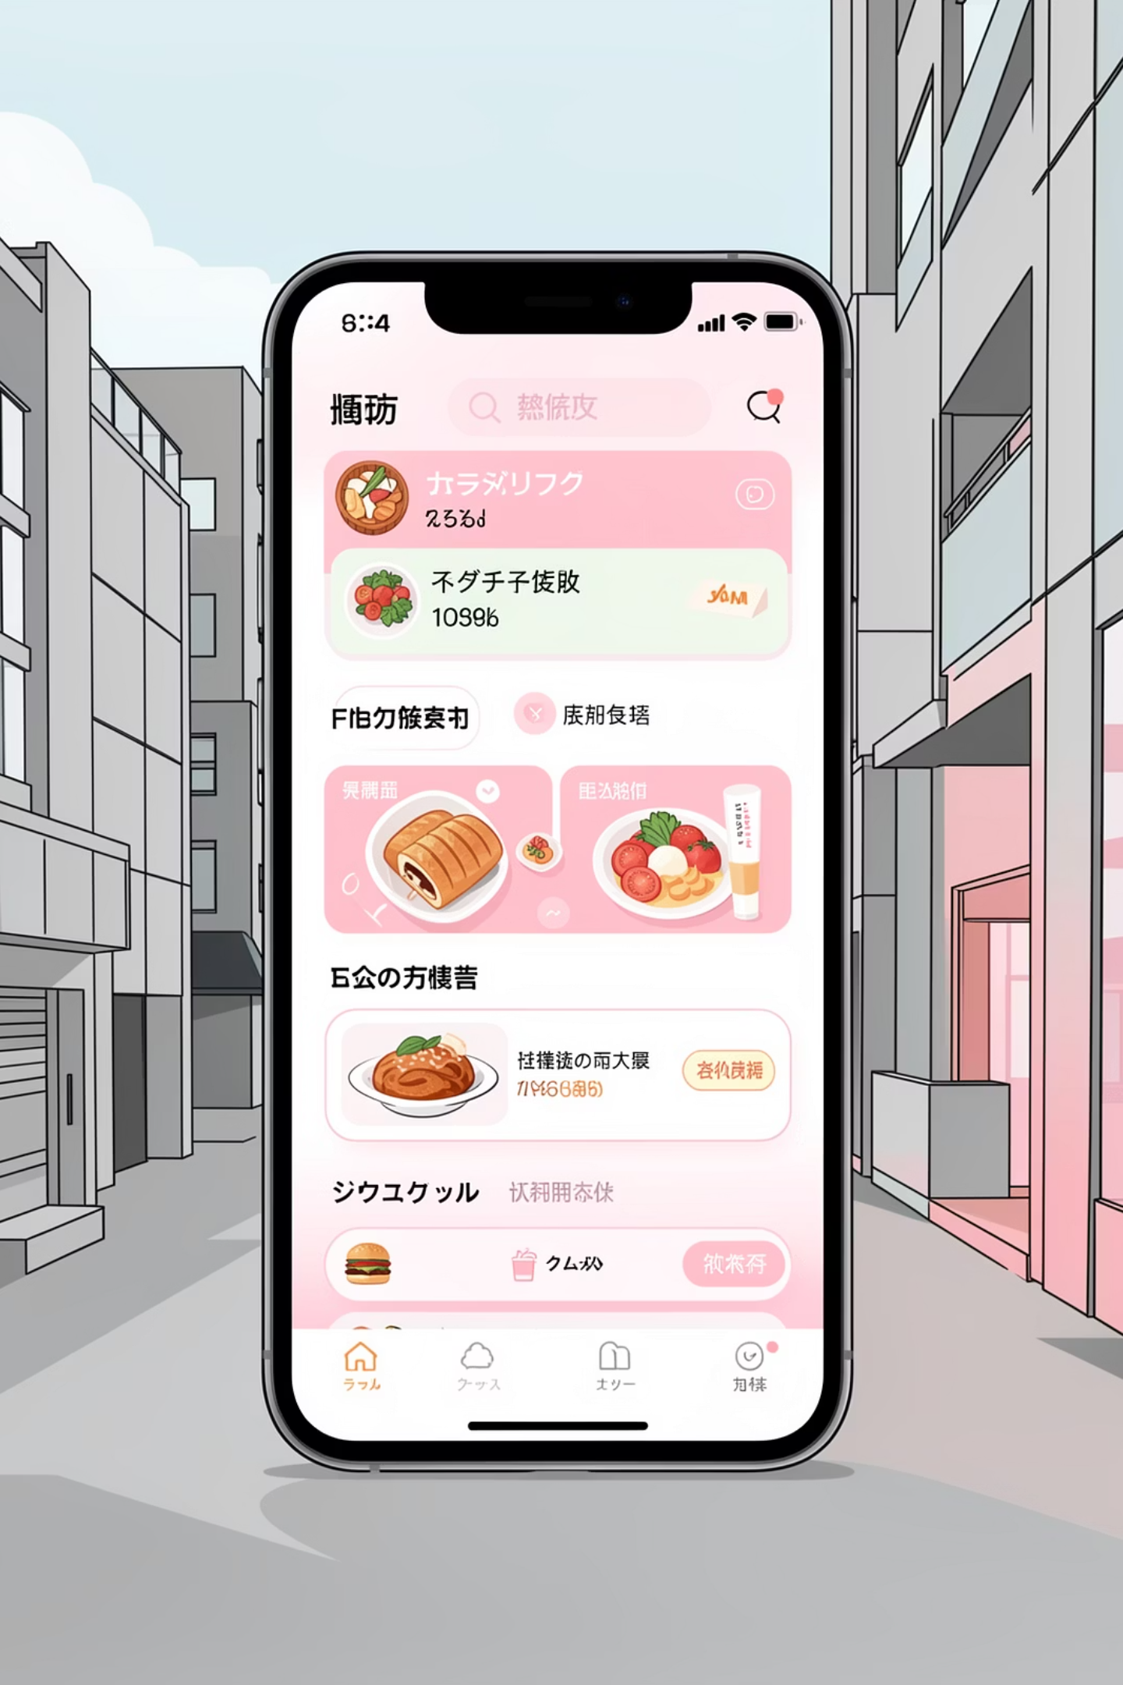
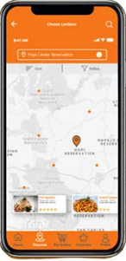
Swiggy Sales Analysis
Data-driven insights from January 2025 – August 2025
Arya Chavan

Slide 2
OVERVIEW
Business Performance at a Glance
₹53M
197K
₹269
4.34
Total Sales
Total Orders
Average Order Value
Average Rating
Strong revenue scale across 8 months
High customer engagement volume
Affordable, high-frequency ordering pattern
Excellent service quality with 5.59M reviews
Arya Chavan

Slide 3
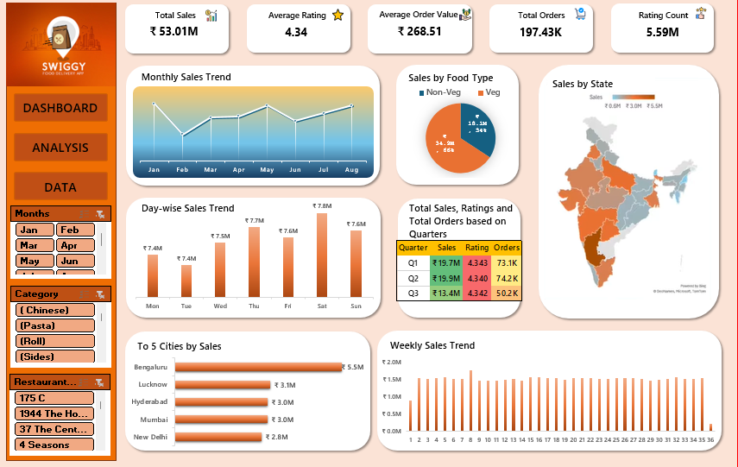
Arya Chavan

Slide 4
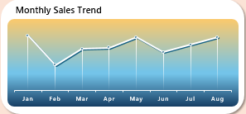
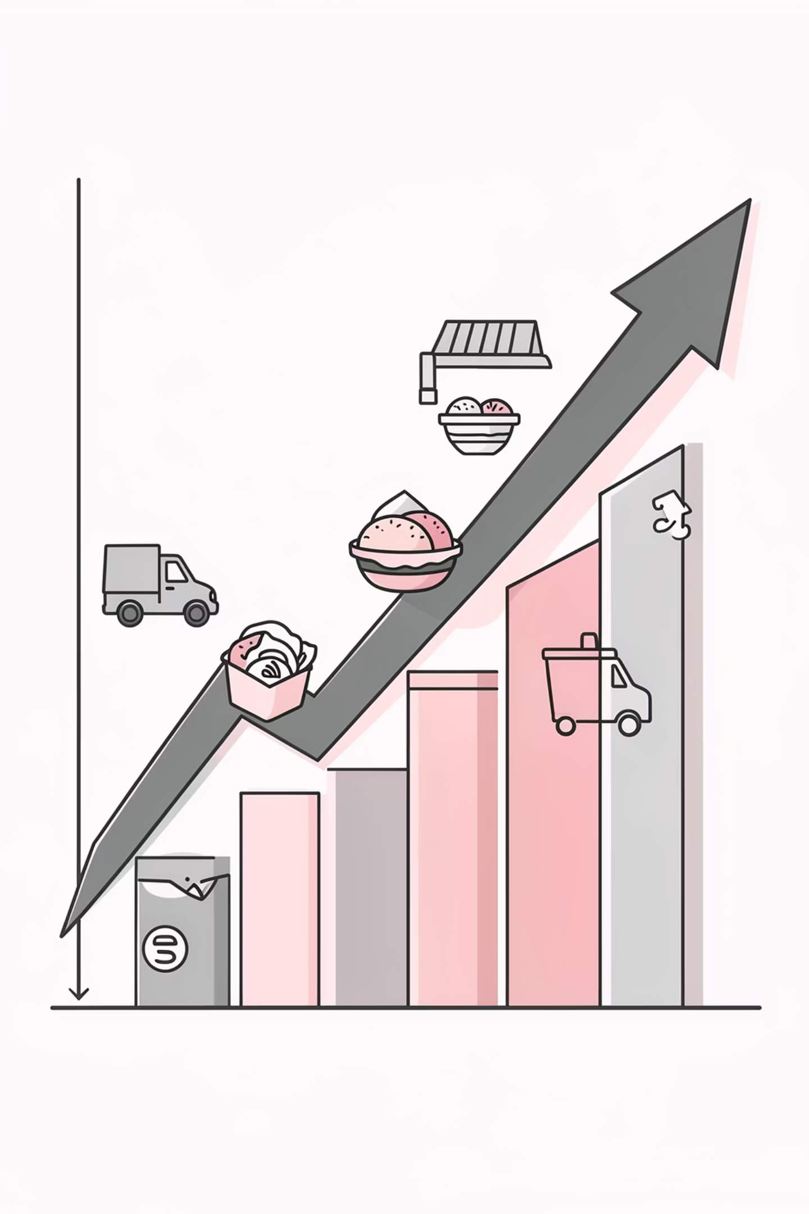
Monthly Sales Trajectory
Sales dipped in February before steadily climbing through May and August. The trend shows no extreme volatility, indicating stable growth and predictable revenue patterns.
Key Takeaway
Stable, repeat-driven business with consistent demand enables confident revenue planning and operational scaling.
This consistency suggests strong customer retention and reliable demand forecasting capabilities for strategic planning.
Arya Chavan

Slide 5
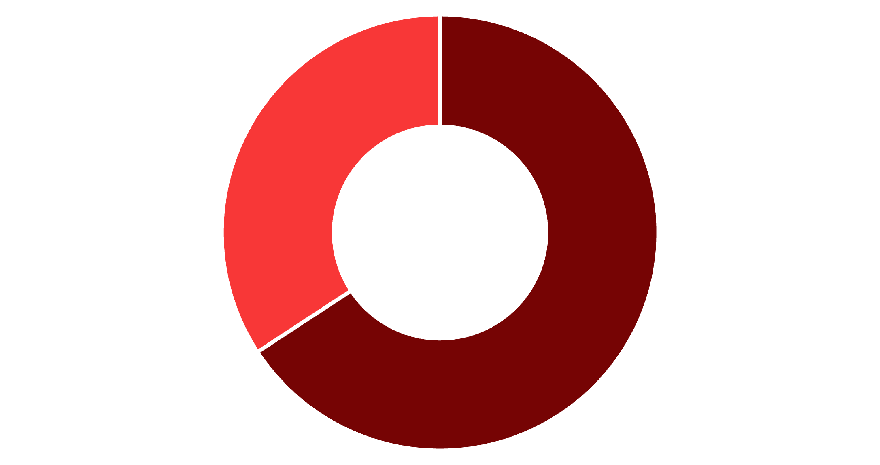
Food Type Revenue Split
Veg Dominates Revenue
Vegetarian orders contribute ₹34.9M (66%) versus ₹18.1M (34%) from non-veg options.
Strategic Opportunity: Launch targeted veg-only campaigns, combo offers, and premium vegetarian menu expansions to capitalize on this dominant segment.
Veg
Non-Veg
Arya Chavan

Slide 6

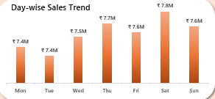

Day-wise Sales Patterns
Weekend Peak
Weekday Dip
Action Plan
Saturday and Sunday drive highest sales volumes
Tuesday and Monday show lowest performance
Deploy combo offers, free delivery, and premium pricing on weekends
Arya Chavan

Slide 7
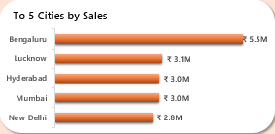




GEOGRAPHIC ANALYSIS
Top Performing Cities
Bengaluru
Lucknow
Hyderabad
Mumbai
₹5.5M – Highest revenue city
Strong Tier-2 growth signal
Consistent metro performance
High-density market leader
Arya Chavan

Slide 8
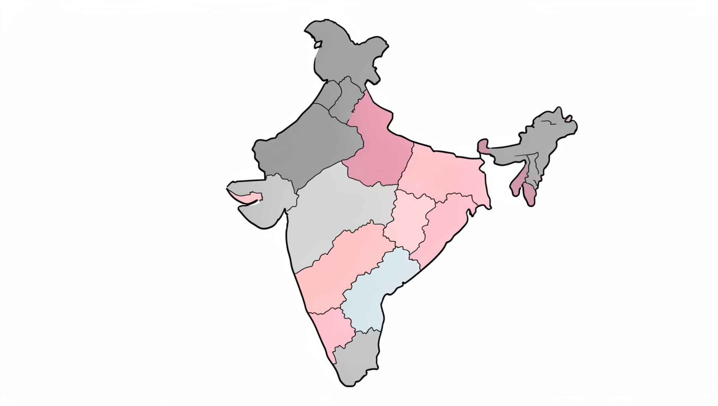
State-wise Revenue Distribution
Regional Strengths
Karnataka
Leading state with strong metro presence
Uttar Pradesh
Emerging Tier-2 expansion opportunity
Telangana
Consistent high-value market
Logistics and restaurant partnerships are strongest in South and West India, with significant penetration in metro-heavy states.
Arya Chavan

Slide 9
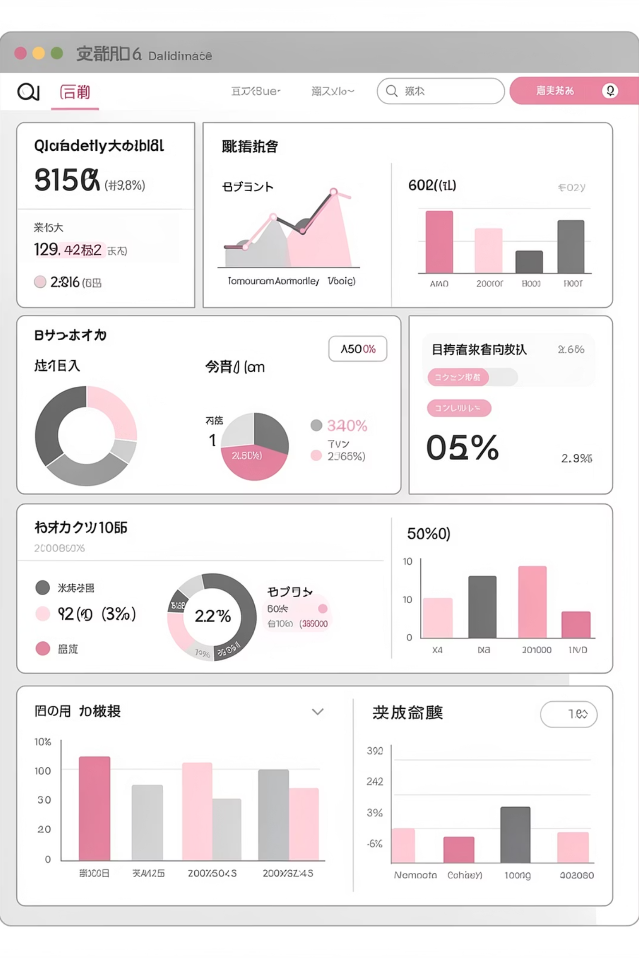
Quarterly Performance Insights
Q2 Peak Performance
Revenue growth does not compromise service quality—an excellent indicator of operational maturity and brand strength.
Highest sales and order volumes recorded in Q2, with ratings maintaining stability at 4.3+ across all quarters.
This balance demonstrates Swiggy's ability to scale volume while maintaining customer satisfaction, a critical competitive advantage in the food delivery market.
Arya Chavan

Slide 10
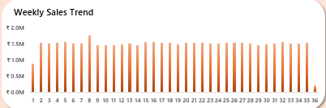

Operational Excellence
Weekly Consistency
Logistics Strength
Predictable Growth
Sales remain uniform across weeks with no major dips, indicating well-managed supply chain operations.
Operational consistency reflects robust delivery infrastructure and reliable partner networks.
Stable patterns enable confident forecasting and strategic resource allocation.
Arya Chavan

Slide 11





Strategic Recommendations
Strengthen Weekends
Deploy premium pricing and exclusive combos during peak Saturday-Sunday demand
Boost Weekdays
Launch Tuesday-Monday promotions to balance weekly revenue distribution
Expand Tier-2
Capitalize on Lucknow's success with targeted Tier-2 city expansion strategy
Veg Focus
Develop premium vegetarian menu offerings to maximize the 66% revenue segment
Arya Chavan

